Slide 1
Superstore Sales Insights
Total sales:14,915,601

Slide 2
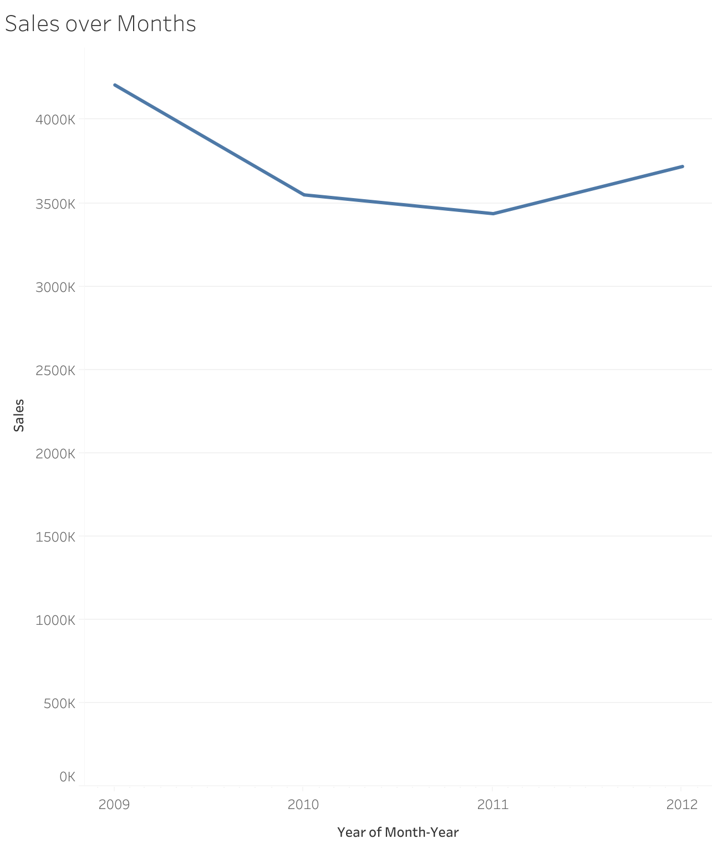
Sales remained relatively stable between 2009–2012, with a slight dip around 2010 and recovery toward 2012.

Slide 3
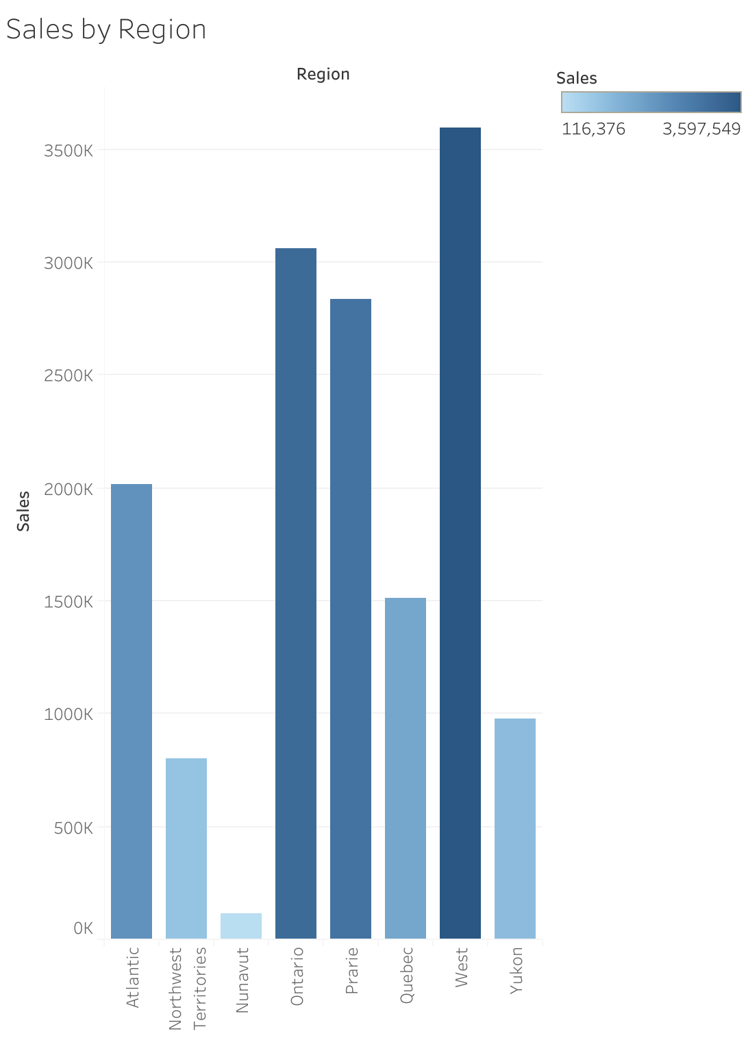
The West region leads with the highest sales (~3.6M), followed by Ontario (~3.1M) and Prairies (~2.8M).
Smaller regions like Nunavut and Northwest Territories contribute very little to overall sales.

Slide 4
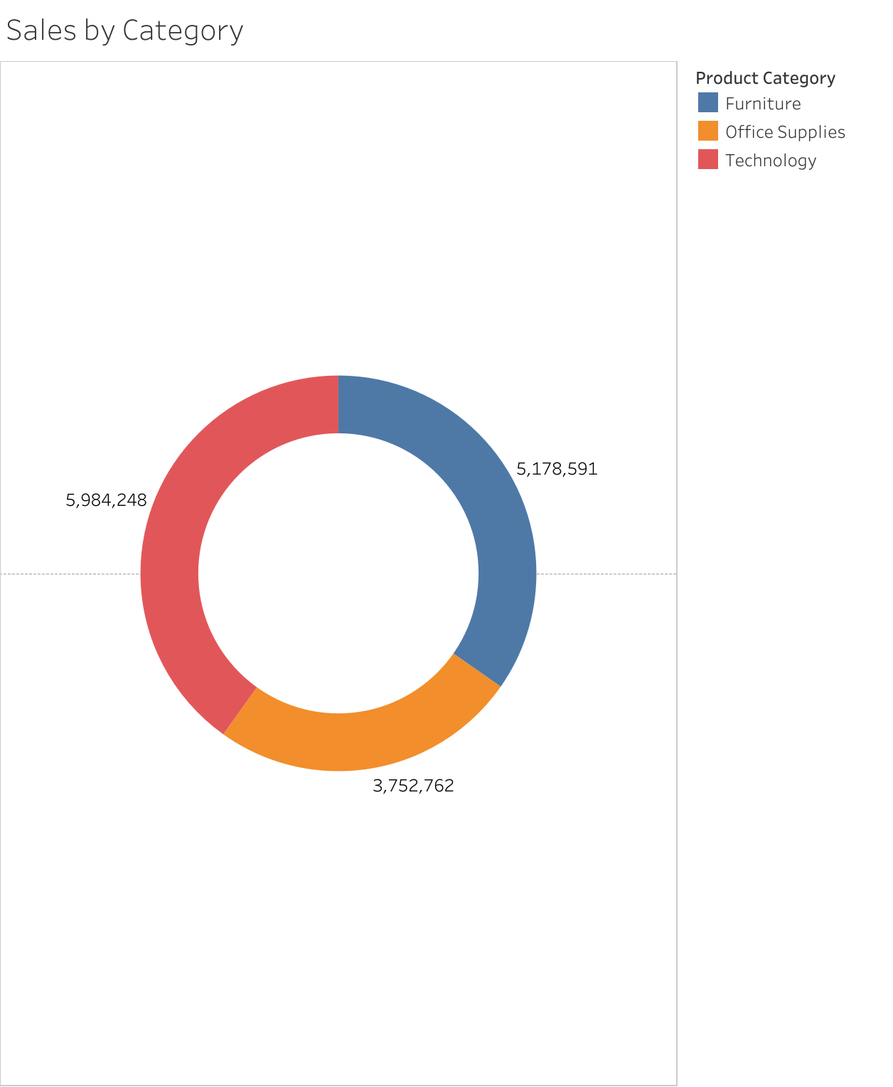
Technology products dominate with nearly 6M sales, showing the strongest category performance.
Furniture (~5.1M) and Office Supplies (~3.7M) follow behind, but both are significant contributors.

Slide 5
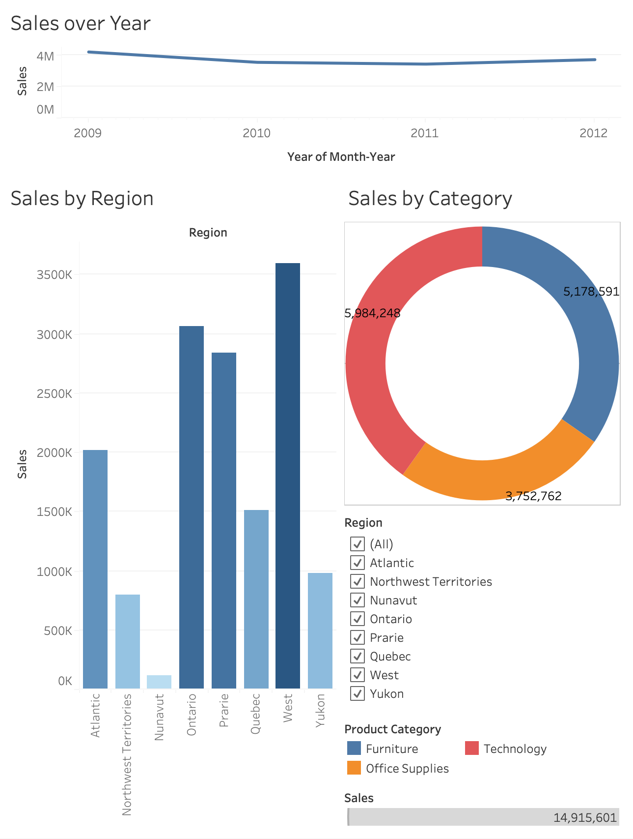
Overall Insight
Regions with low contribution (e.g., Nunavut) may need targeted strategies, while promotions in top-performing categories/regions could further boost revenue.
Growth is strongly driven by Technology sales in the West region.

